Slide 1
Software for Social Good Charles LaPierre charlesl@Benetech.org
Notes:
Hello my name is Charles LaPierre, I am the Technical Lead for DIAGRAM & Born Accessible. My Colleague is Alex Cabral who is our UI/UX research expert at Benetech.
Benetech is a different kind of tech company. We’re a nonprofit based out of Palo Alto, whose mission is to empower communities in need by creating scalable technology solutions.

Slide 2
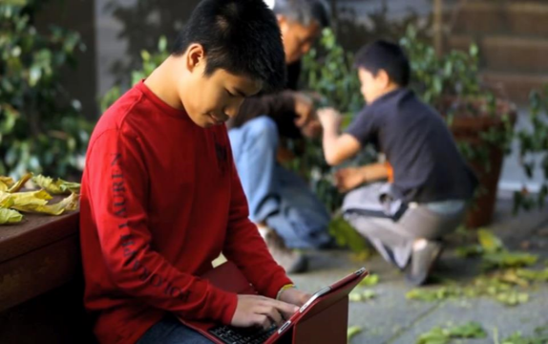
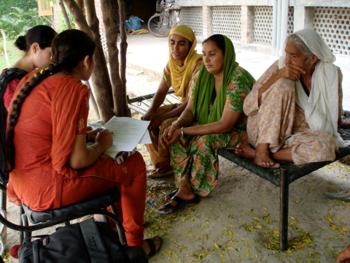
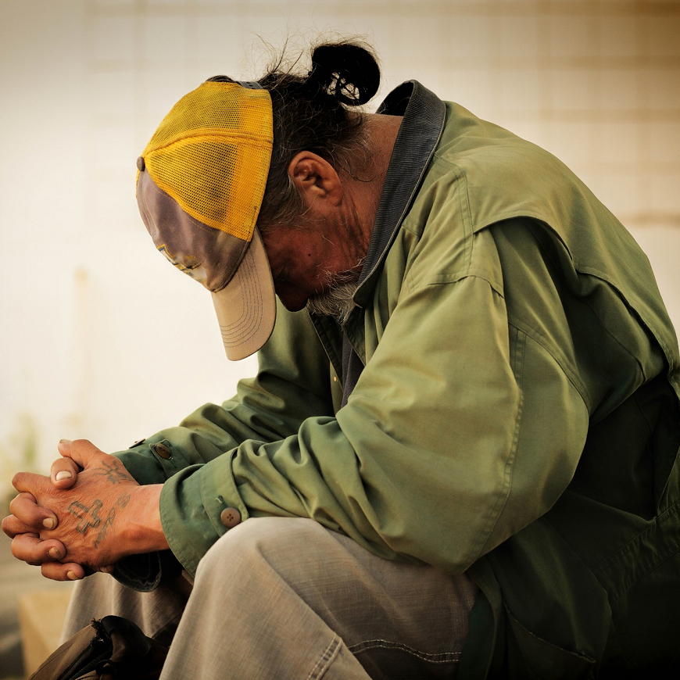
Our work
GLOBAL EDUCATION and LITERACY
HUMAN RIGHTS
We empower communities
with software
for social good
POVERTY ALLEVIATION
Notes:
Our work focuses on global education and literacy, making it safer for human rights defenders in over 50 countries to document and collaborate on human rights violations, and empower those who are struggling to find the resources and services they need to thrive.

Slide 3
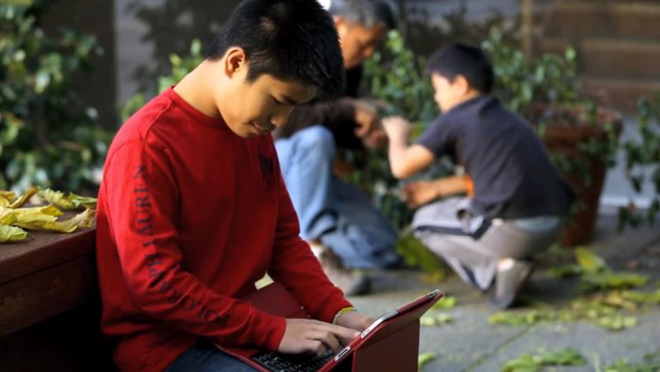
Bridge
We serve as a bridge between the social sector and Silicon Valley to
drive lasting social change
Notes:
Our mission is to leverage technology to help humanity by connecting Silicon Valley technical knowhow with the communities who are in need.

Slide 4
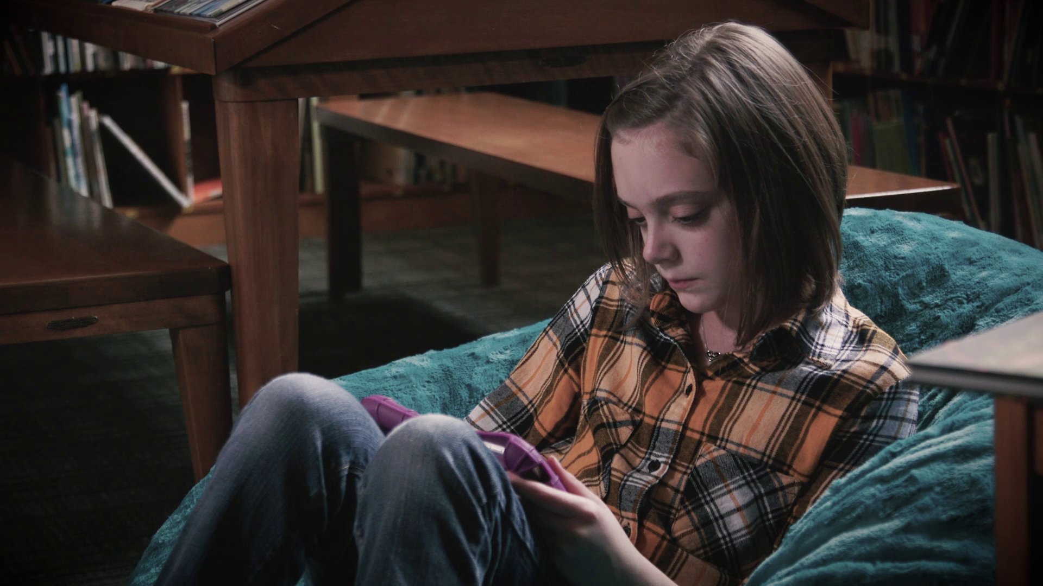

Bookshare Statistics
15 Million+ accessible ebooks delivered
700,000 Bookshare users
780,000+ Books
870 publisher partners
47 languages
Notes:
Bookshare is our flagship success story which is the largest library in the world of accessible books for people with a print disability. Serving over 15 million accessible ebooks, to over 700K users with over 780K books from 870 publishers in 47 languages.

Slide 5
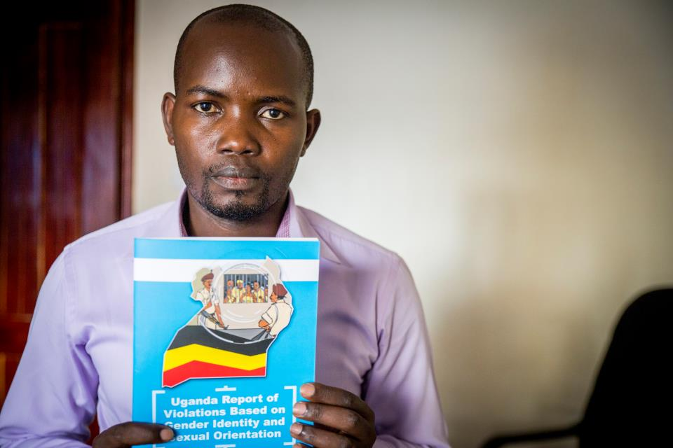
Human Rights
50+ Countries
Thousands of human rights activists securely documented violations
Notes:
Our Human Rights program has made a huge difference in how data is collected securely and now we are focusing on how to privately share and collaborate with video using machine learning.

Slide 6
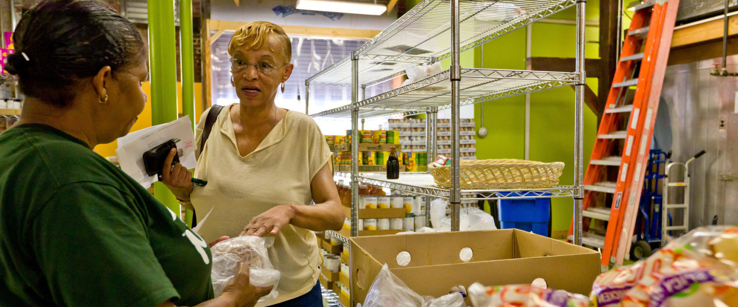
Human Services
1.7 Million
People in the Bay Area with better access to human services*
*Projected
Notes:
ServiceNet and our Data for Inclusion project is helping service providers have access to accurate real-time data about the resources available for their clients.

Slide 7
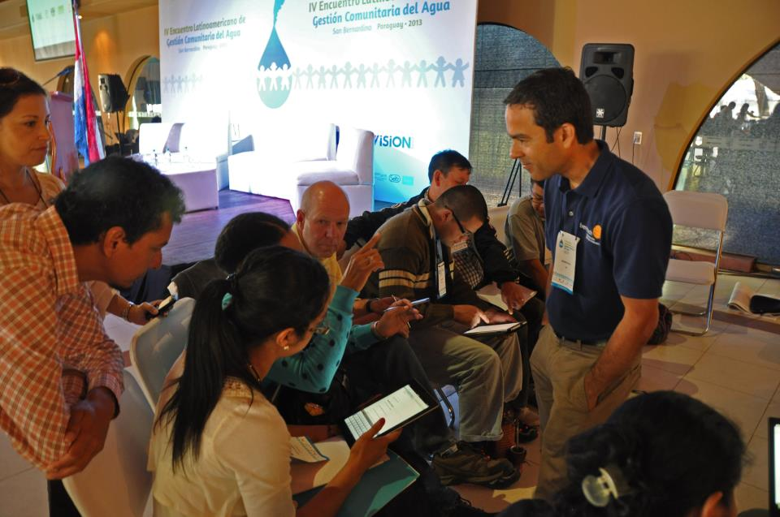
Community Outreach
We advise, build and foster the software for social good ecosystem.
Notes:
We at Benetech advise, build and foster the software which drives a social good ecosystem.

Slide 8

Labs
Notes:
Benetech Labs is working on our next big impact opportunities. Mathshare is one project we feel will change how students learn math on the web, with our accessible user interface that requires students show their work as they solve the equations. Which leads us to today's hackathon where we have two projects that will help our mission at Benetech.

Slide 9
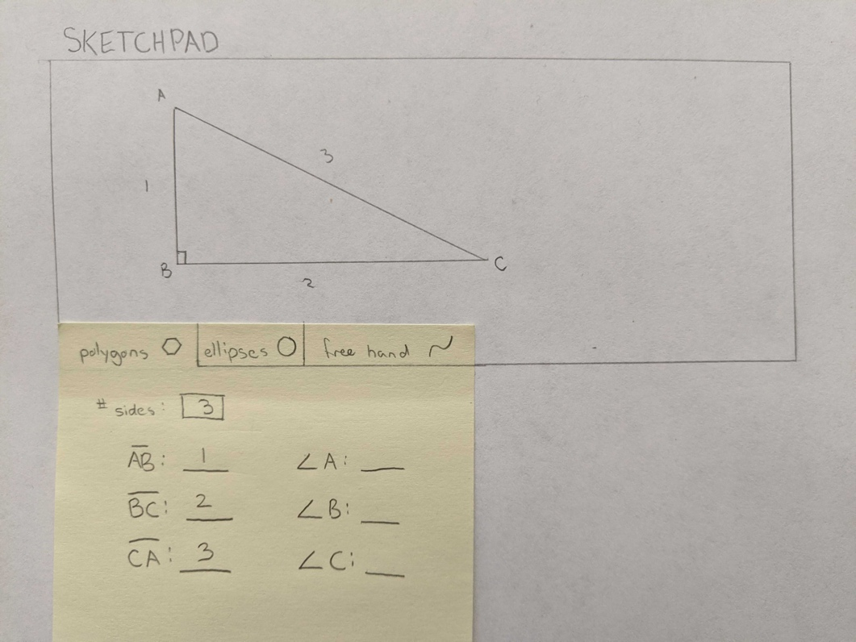
Hackathon IDEA: Accessible Math Sketchpad
GitHub: https://tinyurl.com/ugptajd
Challenge: Create a web-based Accessible Sketchpad that will draw basic geometric shapes based on users input and done in such a way that students can explore the image created in an accessible way!
Notes:
The first is an accessible Sketchpad for Mathshare that will be used to create labelled accessible shapes. Project information can be found at tinyurl.com/ugptajd

Slide 10
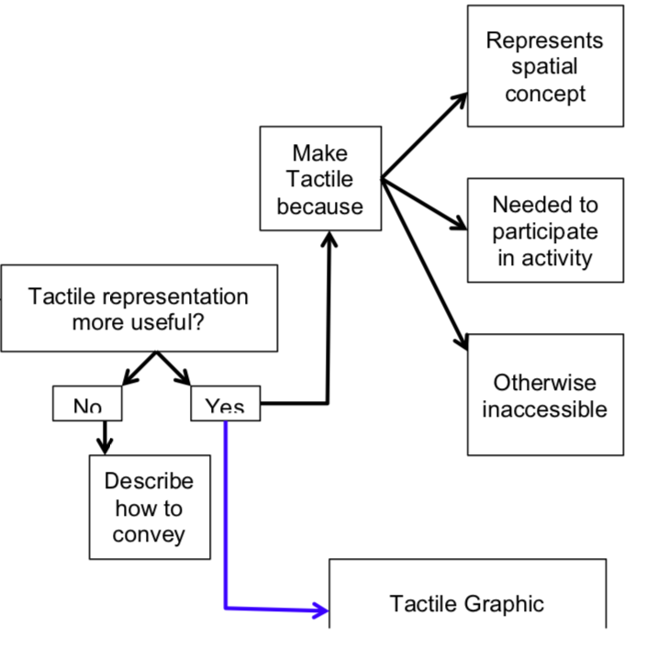
Hackathon IDEA: Accessible Survey Logic
GitHub: https://tinyurl.com/rd6wwbl
Complex surveys that use branching logic based on the answer of a previous question are inaccessible to users that require assistive technology. We need an assessible option!
Notes:
Project idea 2 is an Accessible Survey Logic that will help us create surveys that will ask you different questions based on previous answers which currently is possible but not accessible to those using a screen reader. Project information can be found at tinyurl.com/rd6wwbl

